Slide 1
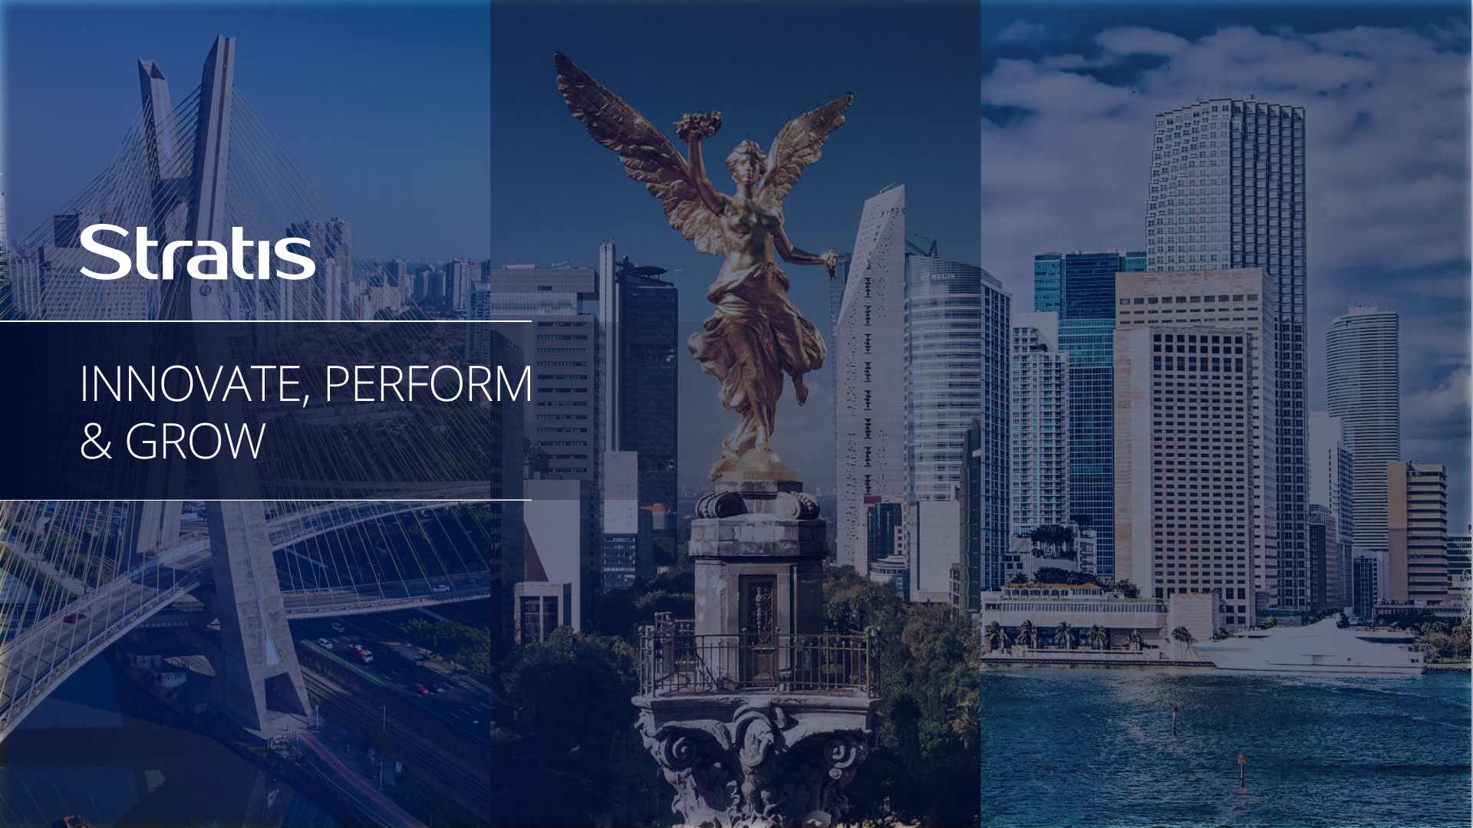
Artificial Intelligence
Applied to QA Processes

Slide 2
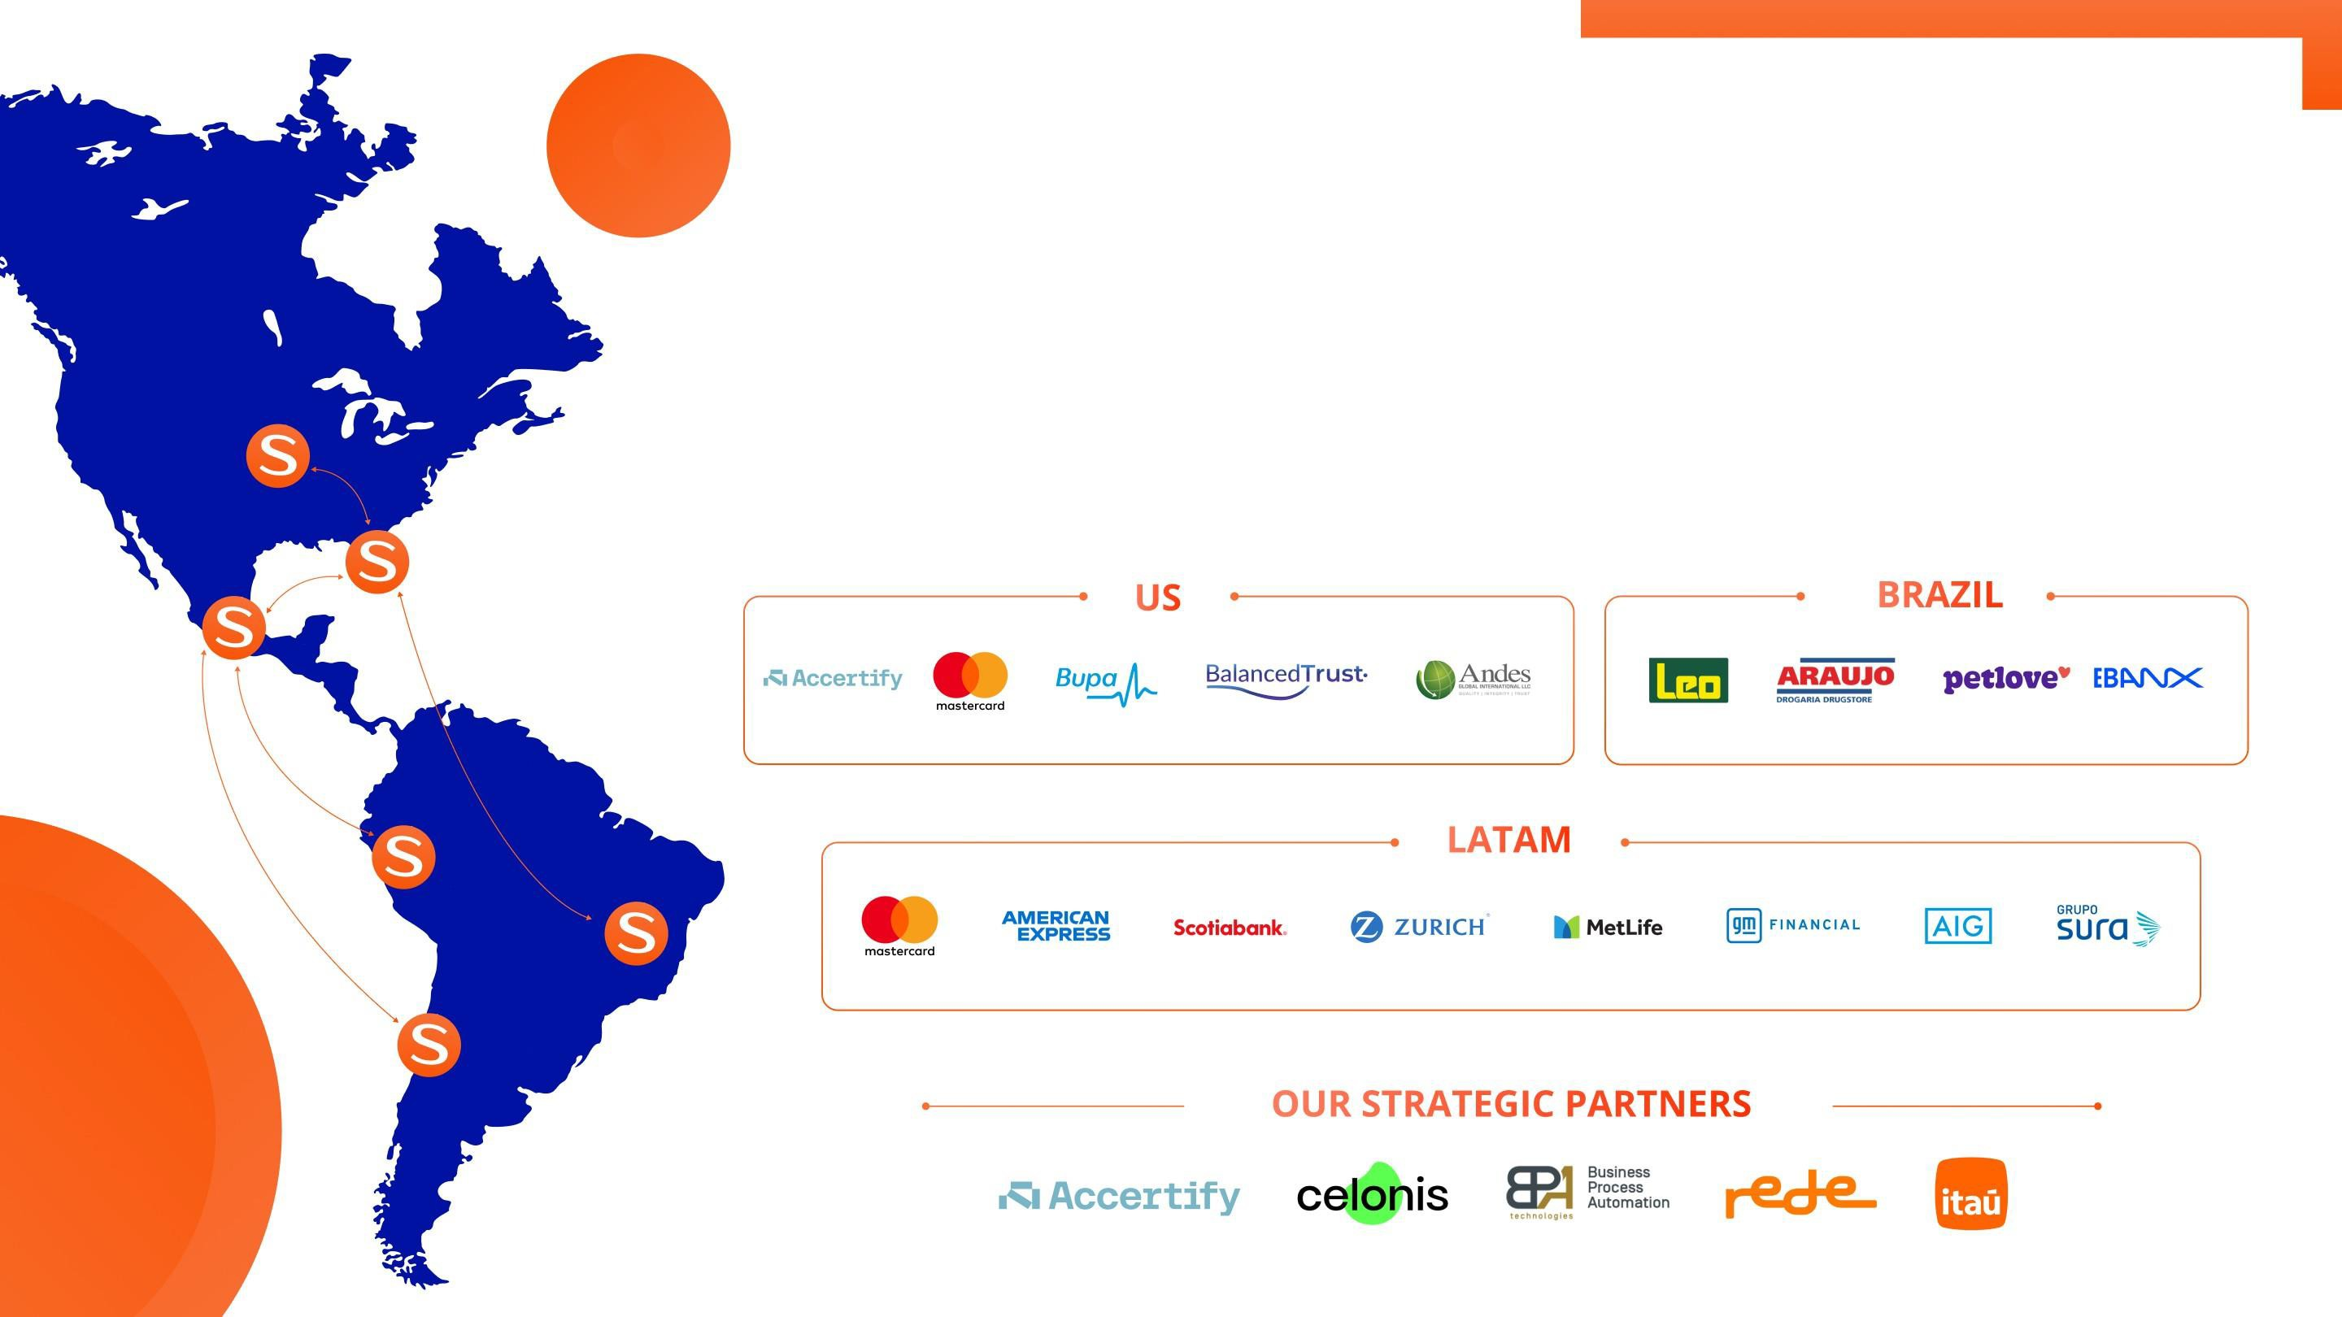
WE ARE STRATIS
Stratis is based in the Americas, with offices in Chicago, Miami, Mexico City, Santiago de Chile, and São Paulo.
Stratis is a specialized provider of technology services known for its agility and client-centric approach. Through continuous investment in innovation and people, Stratis delivers business consulting, drives digital evolution, and ensures the seamless execution of technology projects that create lasting business value.
2

Slide 3

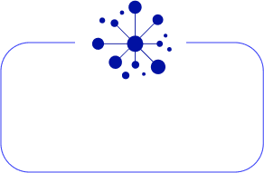
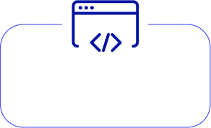
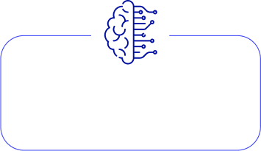
Our Practices
At Stratis, our organizational structure and operational practices are designed to ensure efficiency, adaptability, and value delivery for our clients and talent. Here's an overview of how we are structured and the practices we follow to achieve excellence:
Exploiting the
power of your data
Building technology
solutions for you
Testing your
technology solutions
Define your innovation & optimization strategies, plan and projects
Become an AI powered smarter & more productive organization
1) Cloud / Data
Engineering
2) Digital
Transformation
3) QA Engineering
4) Business & Tech
Consulting
5) Stratis AI
- Data Visualization
- Architecture and ETLs (Extract, Transform, Load)
- Analytics and Predictive Models*
- Governance
- Stratis AI Data Eng
Framework
- Digital Transformation Architecture (Consulting) Digital Agile Factory (Execution)
- Automation
- Stratis AI Development
Framework
- Automation Gap Assessment
- Software Testing Lifecycle, deep design, and productivity enhancement
- Automation
- Stratis AI QA
Framework
- Process Intelligence,
Improvement, & Managment
- Digital Evolution
- Strategic Business
Transformation
- AI Consulting
- Stratis operations optimization AI framework
5

Slide 4
















STRATIS AGILE QA-AI ENGINEERING
Defect Escape Rate
Critical DER
Productivity Increase
A
B
< 3%
< 0.2%
20% - 40%
Product + Development
Virtual Services and QA Environment Management
Stratis Deep Design
Sprint Planning and Prep
3
Planning and
Estimation
Test Environments Config
2
4
QA Committee
Client + Stratis
DAILY
STAND-UP
Exploratory Testing Smoke Tests Functional Testing Non-Functional Testing
User Stories Analysis
1
5
Data Management
Test
Execution
Sprint
Backlog
Sprint Task
Update
UAT
Regression Testing
RELEASE
7
6
Scripts Execution, Maintenance and Optimization
Dev-Sec-Ops: CI/CD Integration and continuous delivery for the Software Development Lifecycle
(Includes Data and Environment Management)
* Depends on the Automation maturity model
AGILE KPI Performance execution and monitoring
Notes:
Incluir lámina de Deep Design
Testing Practice
- What is our approach
- What tolos do we use?

Slide 5








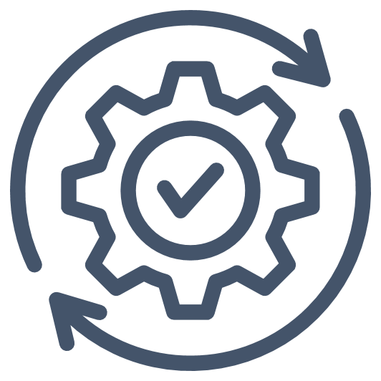









STRATIS DEEP DESIGN METHODOLOGY
Reinforcement Learning
Critical/High
AI Lead
Stratis Deep Design
Tech Lead
Application SME
Product + Development
Staggered Review
TC structure audit
Full Coverage
Feedback and approval
User Stories
Tester + AI Lead
Test Cases
Test Cases +
AI Lead
Automation Scripts
Automator
Large/Complex scenarios:
Single epic
Parallelism within same sprint
Multiple sprints
Designed Test Cases
Defects Found in QA
Defects in Production
How this helps your business:
Low
Medium
Better reputation via fewer defects
Faster Time to Market
Save Time, Money & Efforts
Notes:
Flujo 1:
Tester recibe User Stories y trabaja con Producto y Desarrollo para auditar los requerimientos y asegurarse que sean consistentes. Después se alimentan a los modelos de IA y esta va a entregar Test Cases, los cuales pasarán a Deep Design.
Flujo 2:
Test Cases auditados se alimentan al AI y esta a su vez entrega Scripts de Automatización los cuales van a pasar por una última auditoria y ajuste.
Better company image through fewer defects
Confianza a través de la cooperación humano + AI

Slide 6

OBJETIVE
Run a Live Demo to highlight how leveraging Artificial Intelligence can drive significant improvement in quality in order to execute an end-to-end testing cycle.
The sample app is a case management tool (Case Master) with the following features:
Analyst & customer portal
Create new case
Upload documents
Case tracking
Case filtering: Customer, Merchant, Commercial
Set priority, due date, etc.
AI-driven generation:
Application documentation: System + User
User stories
Test cases
Automation framework
Automation scripts

Slide 7





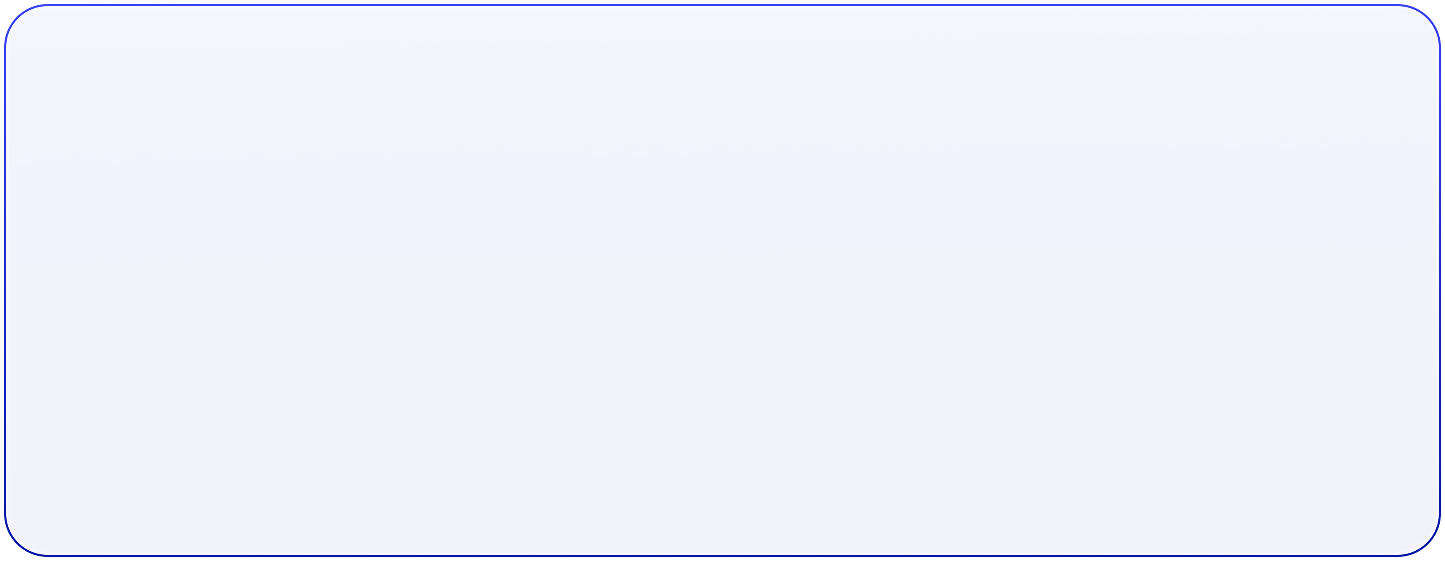
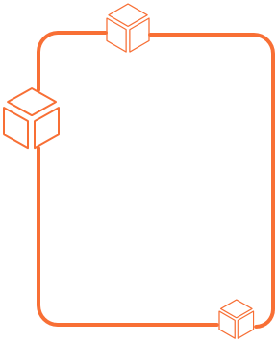







0
1
2
3
Application is fully documented
App documentation is used to generate User Stories
User Stories generate Test Cases (Feature Files)
Application Analysis
5
4
A complete Automation Framework is built:
Test Cases are uploaded to Jira
7
6
Automated test case execution
Execution report
Test cases are updated in Jira (status, evidence, etc.)
Step Definitions
Ouput
Page Objects
Utilities
Reporting Module

Slide 8
STRATIS PROPOSAL & NEXT STEPS
Conduct Assessment of Disputes Product Testing Practices and Automation – Stratis Investment
Present Findings and Recommendations
Submit approval request to AI Governance Board for AI Testing- In Paralell
Implement Deep Design Methodology
Implement AI-driven testing methodology

Slide 9


Slide 10


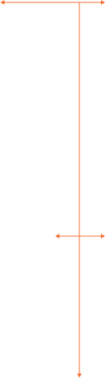

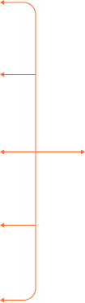




UAT
STRATIS AI FRAMEWORK
Test Cases UAT
Functional Testing
Desktop Application
Agents
LLMs
Design
Automation Scripting
GitHub Copilot
GPT
Documentation
Figma prototype
Web-Based
Desktop (1A)
Windsurf
Claude
User Stories
Mobile
API
Website
Cursor AI
Gemini
Test Cases
Microsoft Copilot
Stratis
Mobile App
Chat GPT
AI-Driven Automation Framework Development
Stratis AI Knowledge Management
Client Automation Framework
Web-Based Application
CUSTOM
Management
Performance
AI Core
XRay (1B)
Security
JIRA
Accessibility
Non-Functional Testing
Notes:
Agregar riesgos de no hacerlo con Stratis

